Slide 1

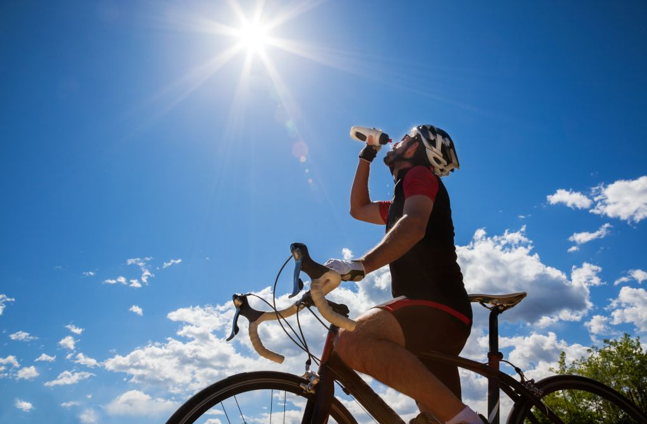
Level of Heat Stress Mapping
Farzaneh Farshad|300124641|GEO5153

Slide 2




Literature
One of critical fundament of public health and active transport policy is Cycling (Iseki & Tingstrom, 2014)
average temperatures are creeping up due to the climate change
Associated Health problems, sedentary life style, obesity, respiratory disease, diabetes, cardiovascular disease etc. are increasing due to the car dependent cities and suburbs (Cervero & Duncan, 2003)
To compensate the serious safety problems of cycling, especially when the average temperatures are creeping up due to climate change and the number of extreme heat days that has been started to be experienced by residents of most Canadian cities is rising, this study tries to identify the level of heat stress that exist on pedestrians and cycling trails , and it will be a platform for planning future ‘shade corridors’ for pedestrians and cyclists.

Slide 3

Objective
Develop index overlay methodology to provide route guidance based on minimizing heat load (suitability map for cycling) on 5 sample cycling trails.
Compare the sample trails after applying index overlay method for future tree planting plans

Slide 4
Future Benefits
planning analyses which travelers can make decision of taking routes for cycling based on the effort and energy required
Identifying existing, and planning future ‘shade corridors’ for pedestrians and cyclists by prioritize tree planting
May lead to a new urban planning metric

Slide 5
Potential Sample Routes Chosen for this Project
ROUTE 1: DAZÉ ST TO 3421-3419 OTTAWA 32
ROUTE 2: ALBERT ST. TO ST. LAURENT / HEMLOCK
ROUTE 3: CONSTELLATION Dr. To WESTBRO STATION LIVING
ROUTE 4 :444-432 RICHMOND RD TO CENTREPOINTE, NEPEAN
ROUTE 5 : WOODVALE GREEN TO BELLS CORNERS UNION CEMETERY

Slide 6
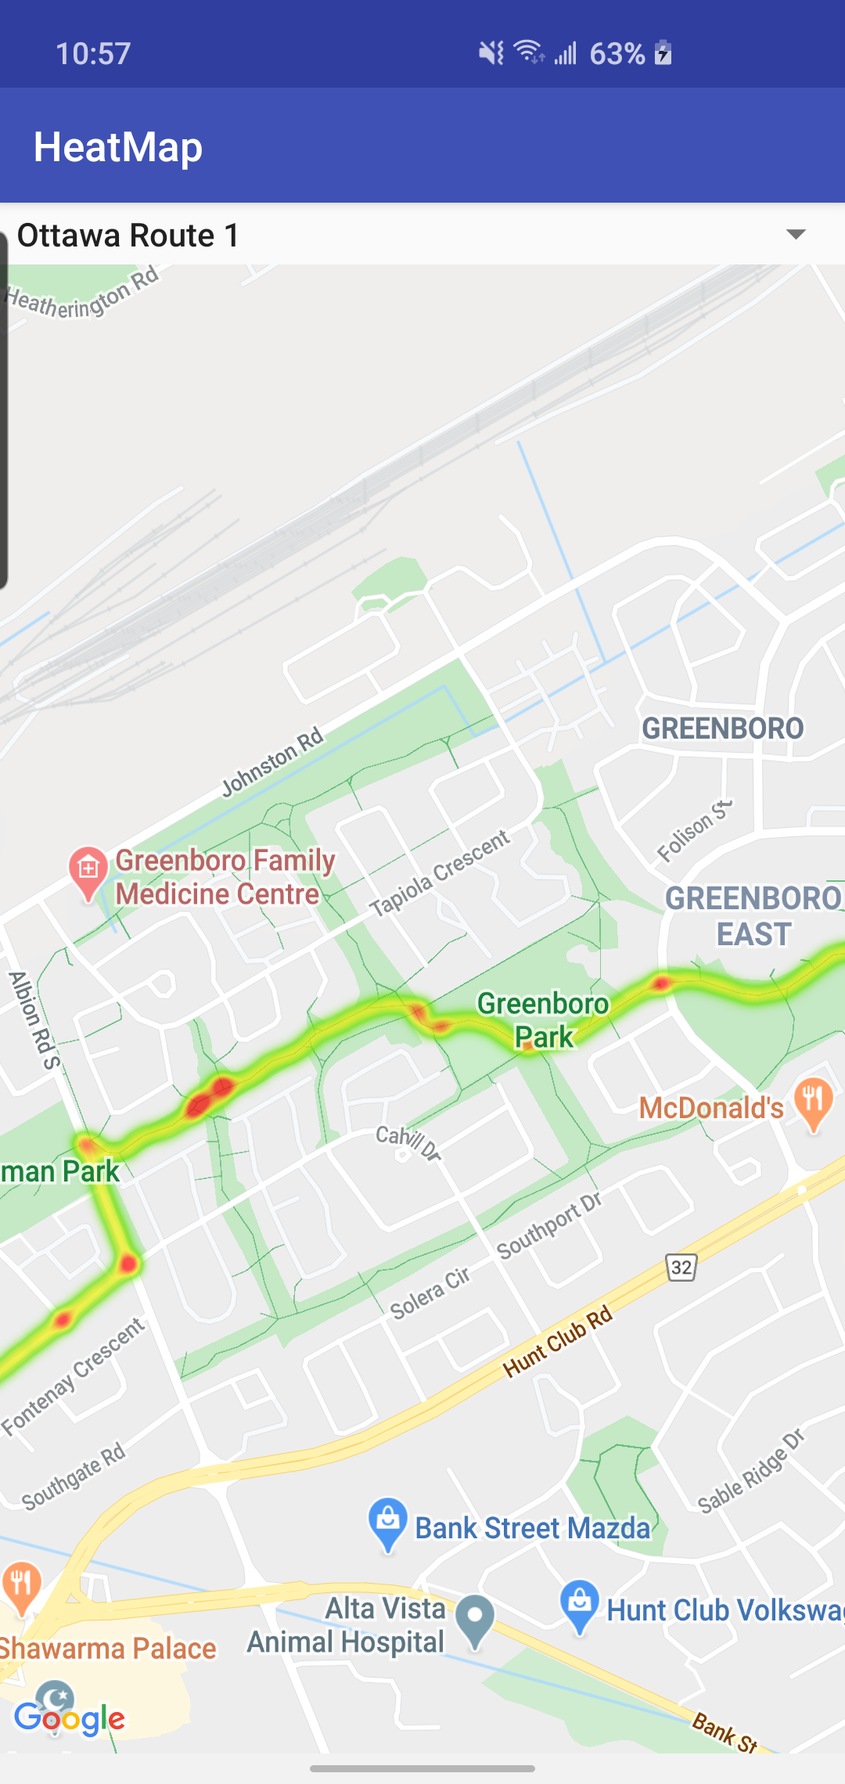
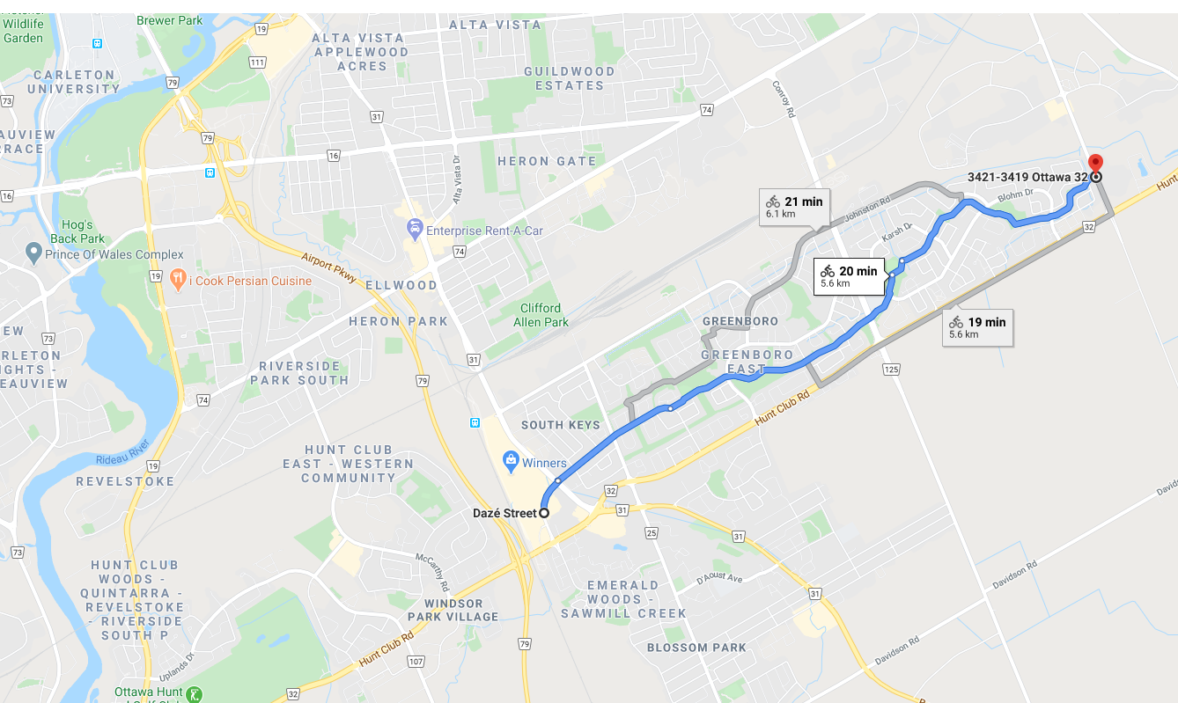
Sample Routes
ROUTE 1: DAZÉ ST TO 3421-3419 OTTAWA 32

Slide 7
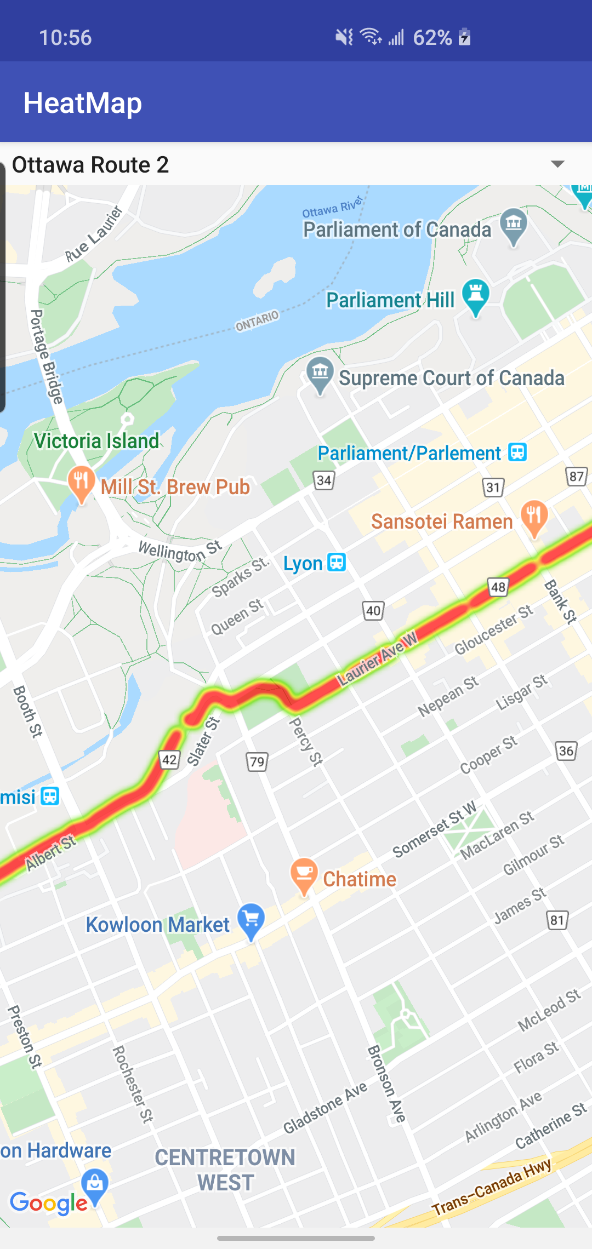
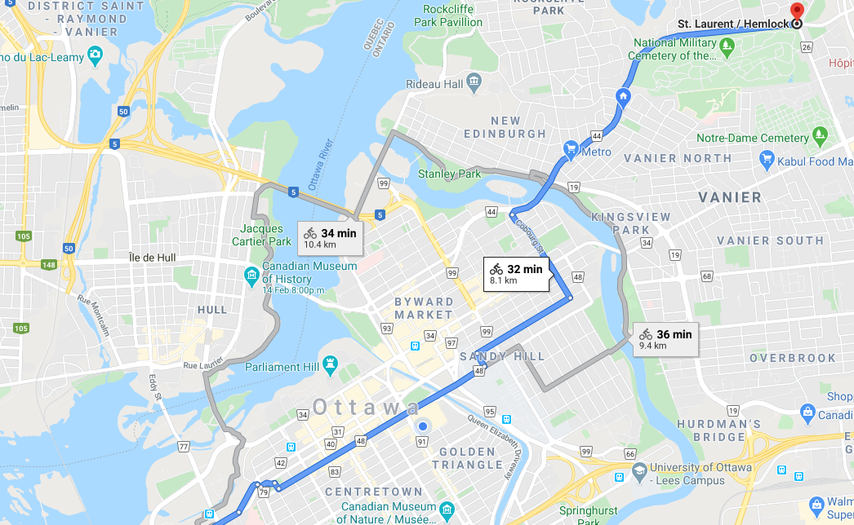
Sample Routes
ROUTE 2: ALBERT ST. TO ST. LAURENT / HEMLOCK

Slide 8
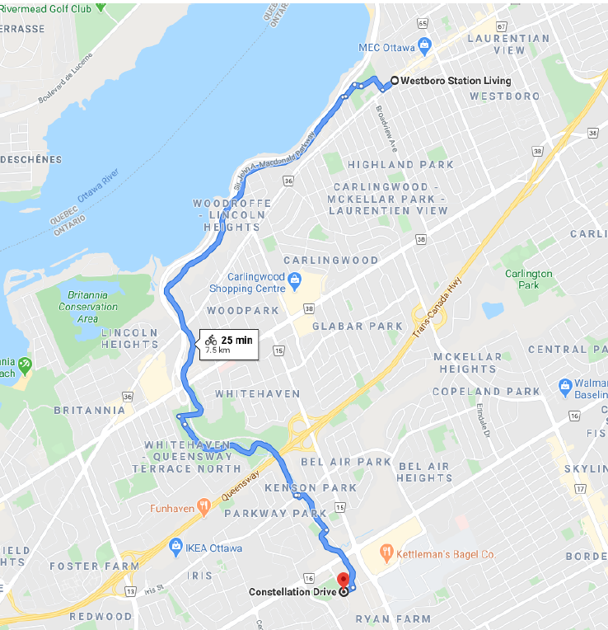
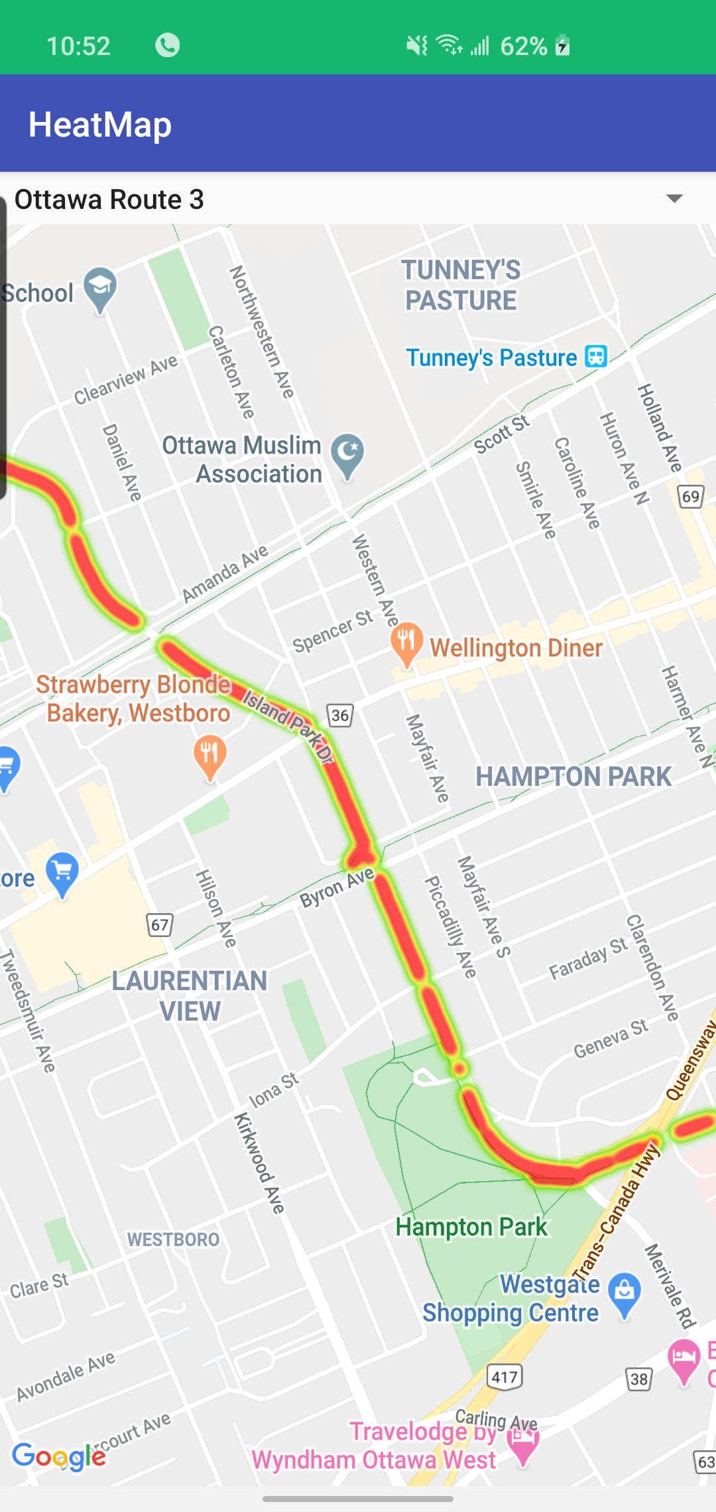
Sample Routes
ROUTE 3: Constellation Dr. To Westboro Station Living

Slide 9
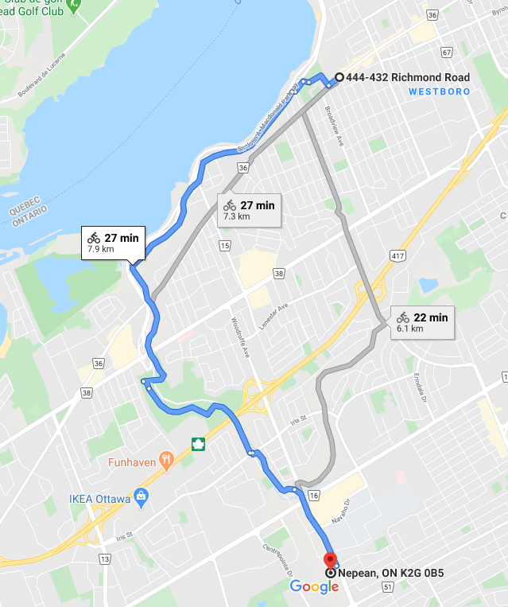
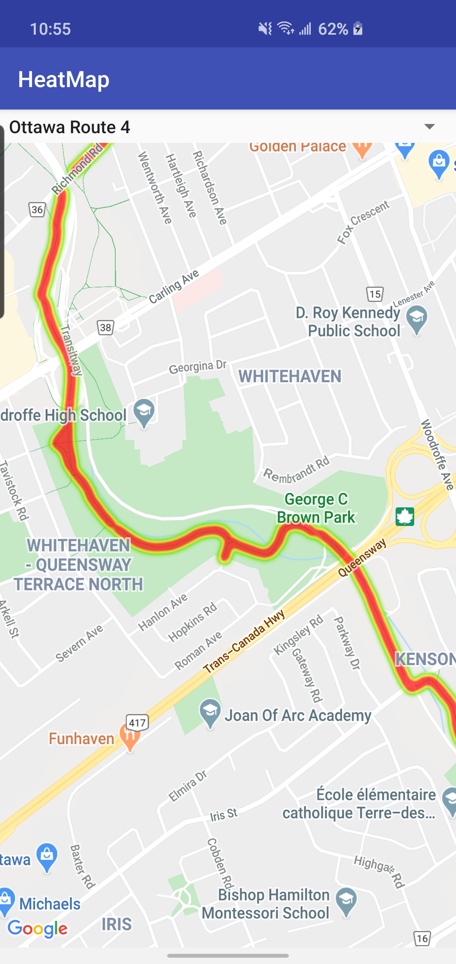
Sample Routes
ROUTE 4 :444-432 RICHMOND RD TO CENTREPOINTE, NEPEAN,

Slide 10
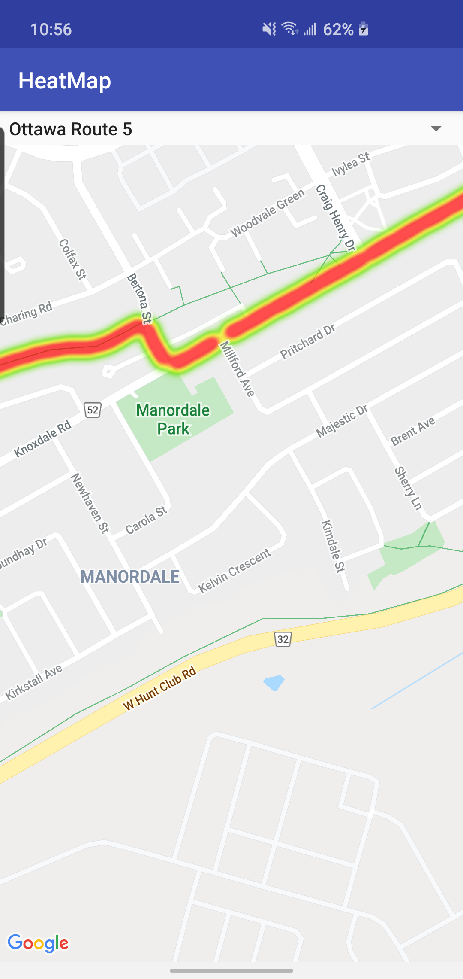
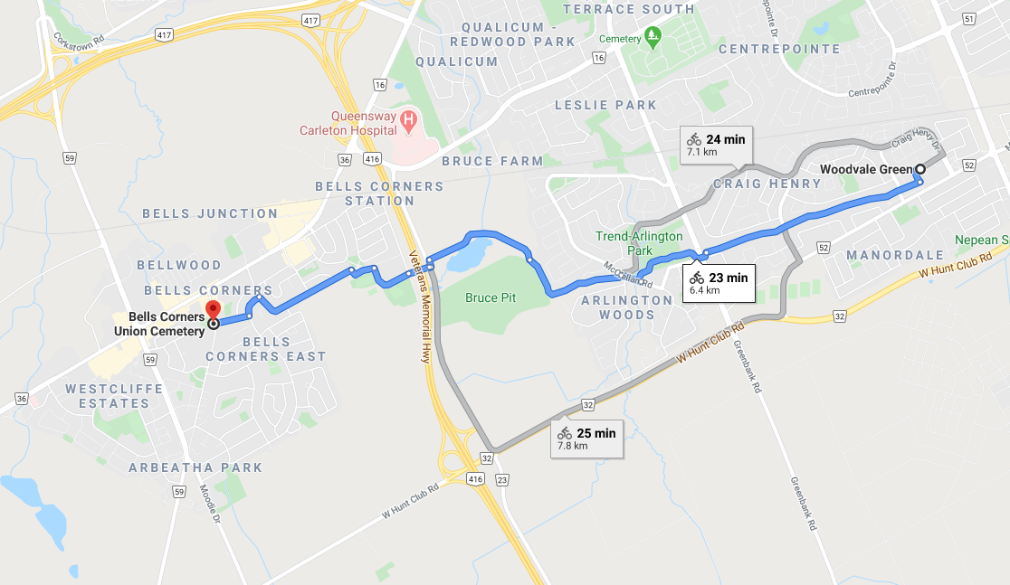
Sample Routes
ROUTE 5 : WOODVALE GREEN TO BELLS CORNERS UNION CEMETERY

Slide 11
Flow Chart
Data Preparation
Step 1
Data input
Step 2
Process
Step 3
The most time consuming and hardest part of this project was collecting and preparing data. The data that we used for this project based on the literature review was : 1- DSM of Ottawa to extract slope map from it
2- Landsat images to extract temperature of the locations in the trails and considering heat island effect
3- Tree canopies around the chosen trails
Analysing results
Step 4

Slide 12
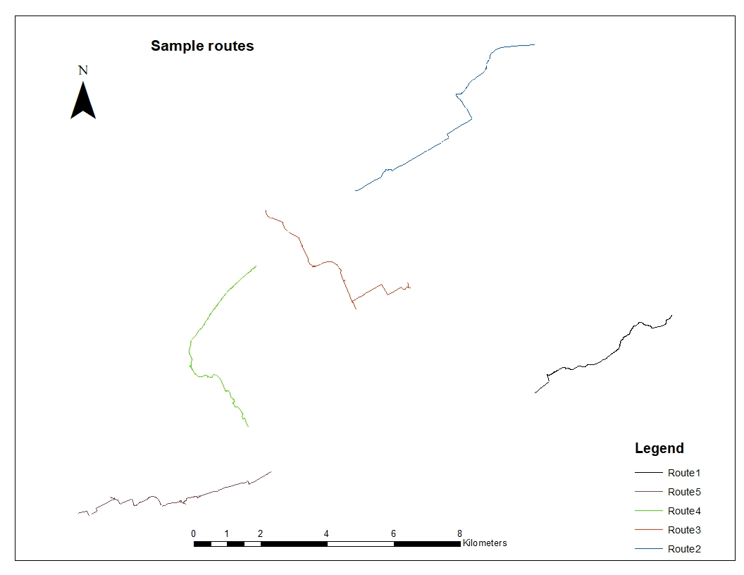
Step 1: Data Preparation (Extract routes)
By downloading cycling network from https://open.ottawa.ca/ I was able to extract sample trails by selecting polylines and merge them to a single line through Create Routes (Linear Referencing) tool in ArcGIS

Slide 13
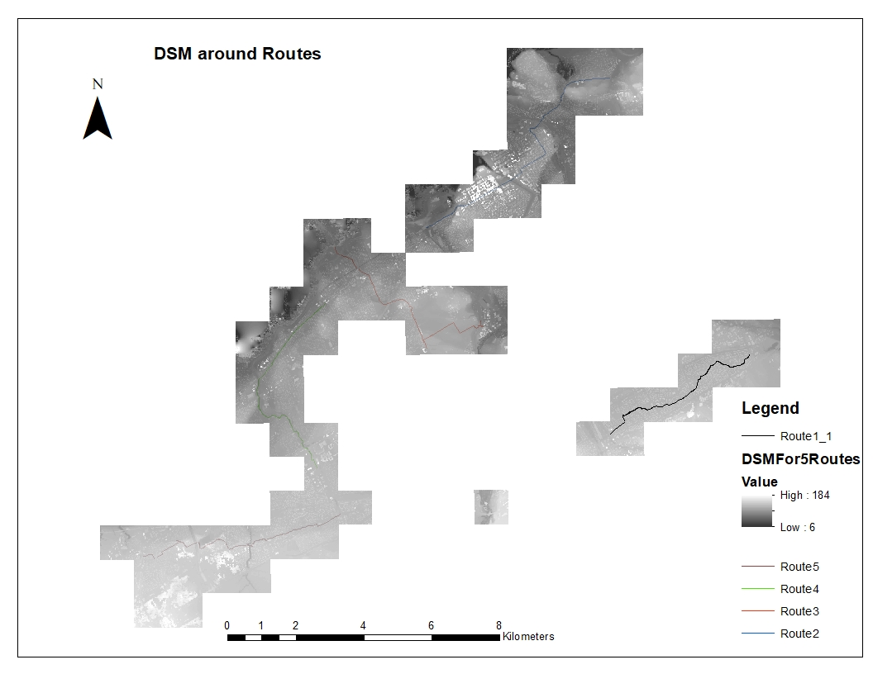
Step 1: Data Preparation (DSM-Slope)
DSM files around the trails were collected from: https://geohub.lio.gov.on.ca/datasets/mnrf::ontario-digital-surface-model-imagery-derived
Because they were different images around the trails, we had to mosaic those rasters to new one then we extract Slope map from DSM

Slide 14
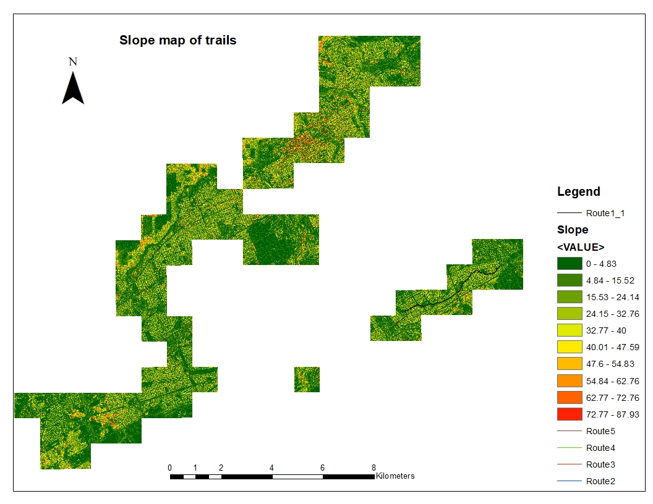
Step 1: Data Preparation (DSM-Slope)
Slope map using Slope (Spatial Analyst) and DSM as an input raster and based on degree.

Slide 15
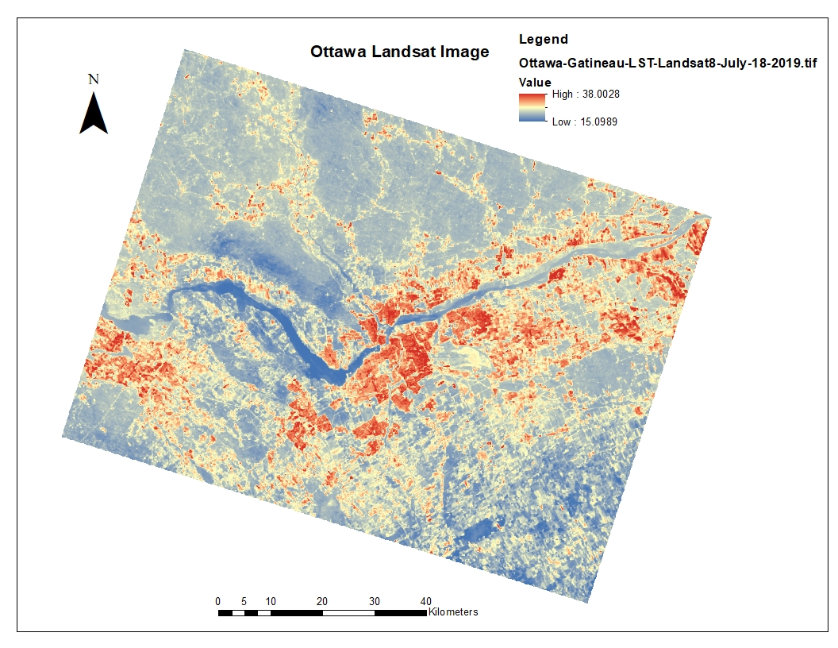
Step 1: Data Preparation (Landsat2018)
Landsat image is going to show the temperature through the trails and the impact of heat island effect

Slide 16
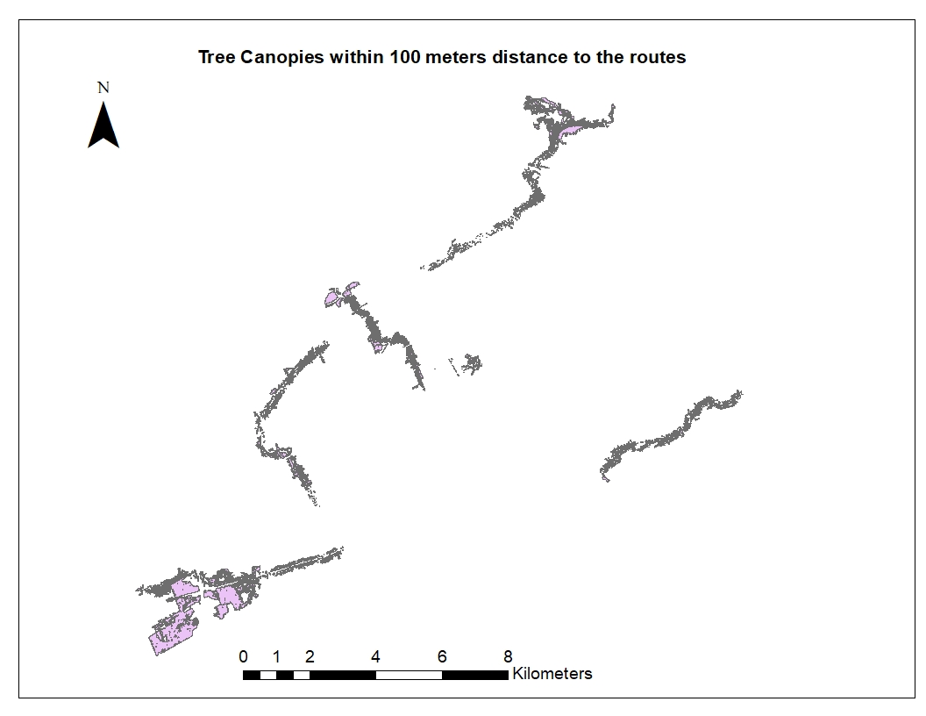
Step 1: Data Preparation (Tree Canopies)
The tree canopy shape file within 100 meter distance to the trails was given by city of Ottawa GIS department. To input this data to our calculations we should change it to raster file and also we should consider that the trees with the distance more than 10 meter to the trails does not really make any shades on the trail so we should limit the tree canopy file to 10 meter instead of 100 meter.

Slide 17
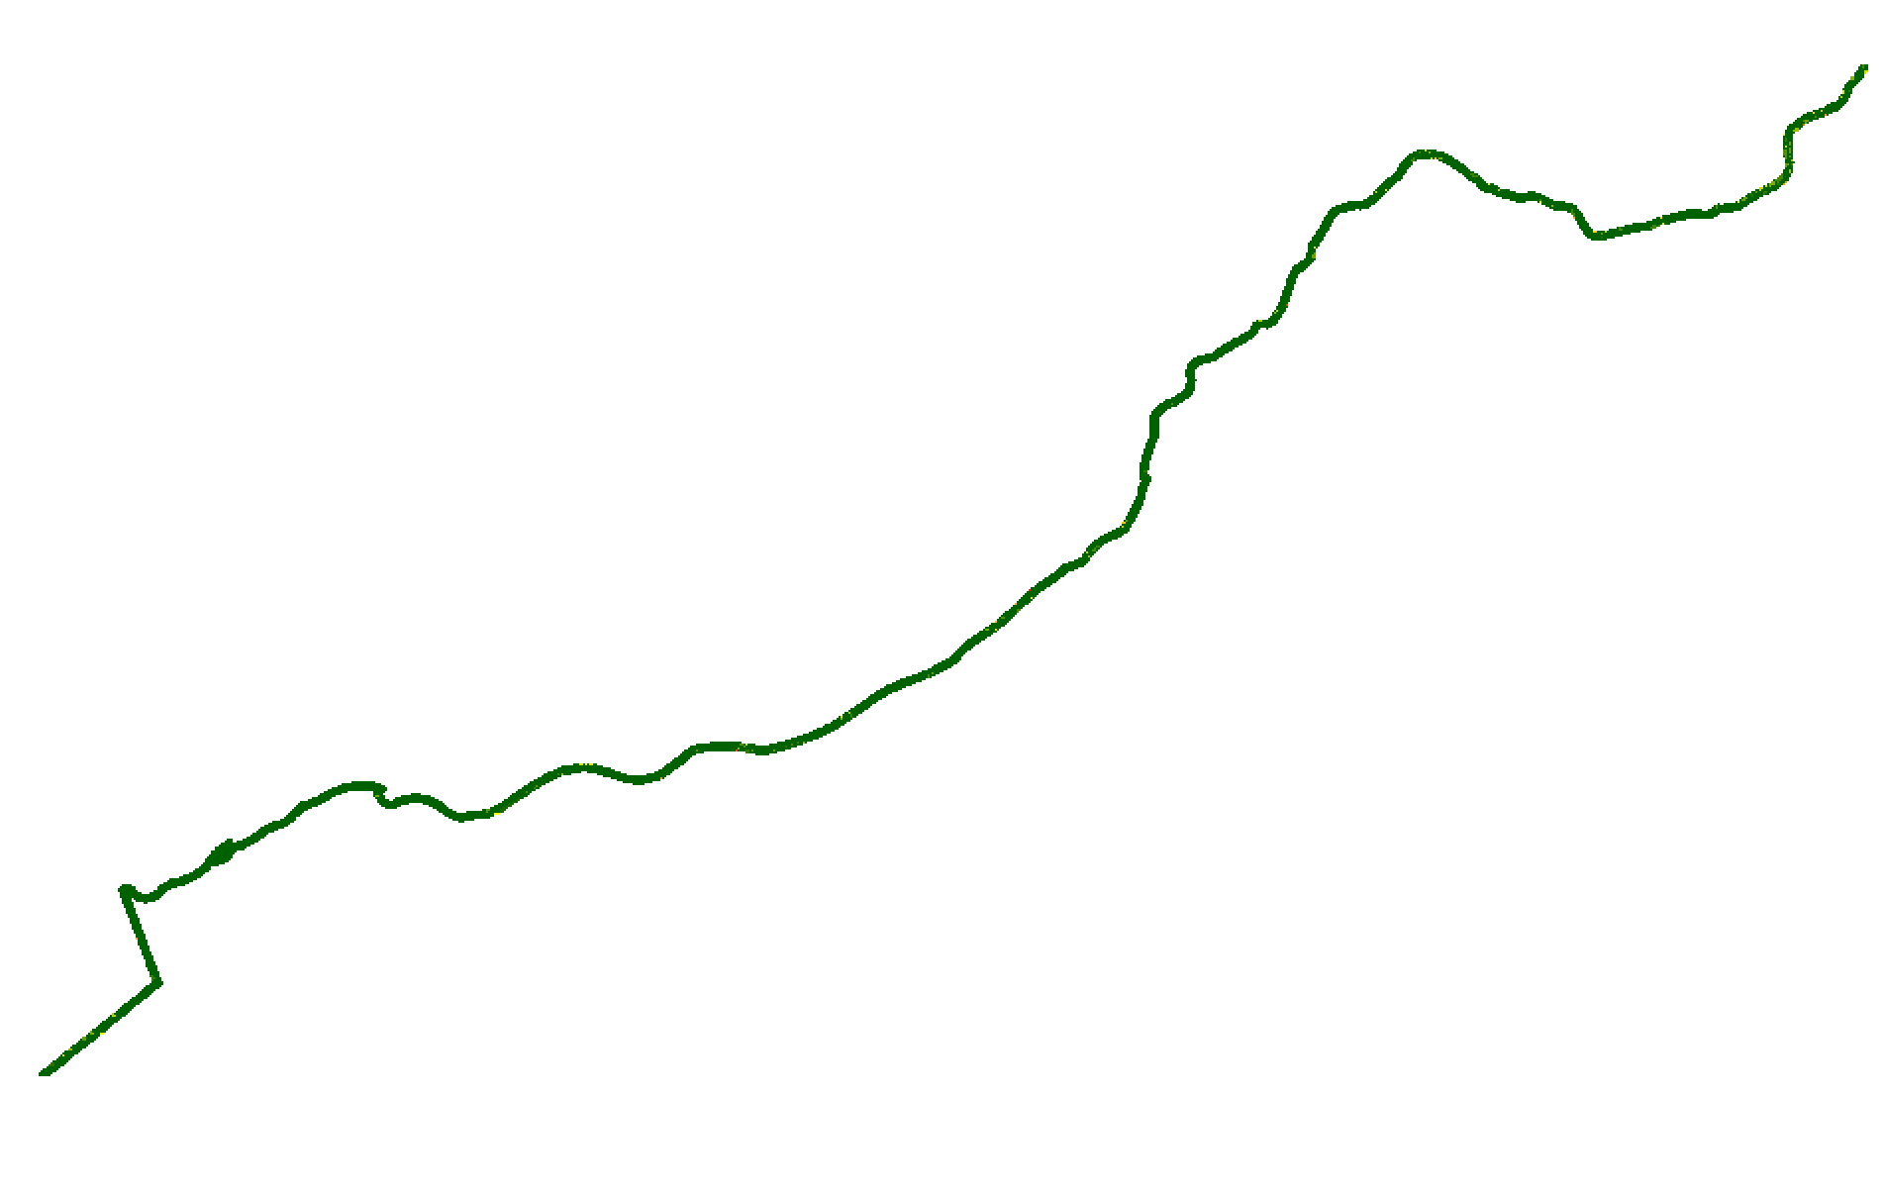
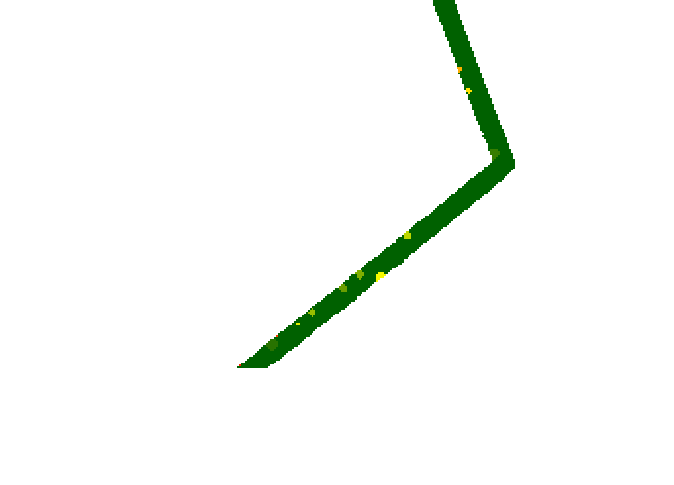
Step 1: Data Preparation (Tree Canopies)
To process the tree canopy file I used “Select by Location” tool. I select polygons of tree canopy that their centers are inside the 10 meter buffer zone of the trails and then I saved them as a new polygon file. Then the new polygon file was changed from vector to raster by “feature to raster” tool. Here in the picture you will see that the tree canopy limited to the route by 10 meters and transferred to raster.
The more green the color the nearer the trees to the trail. So, it will be cooler.

Slide 18
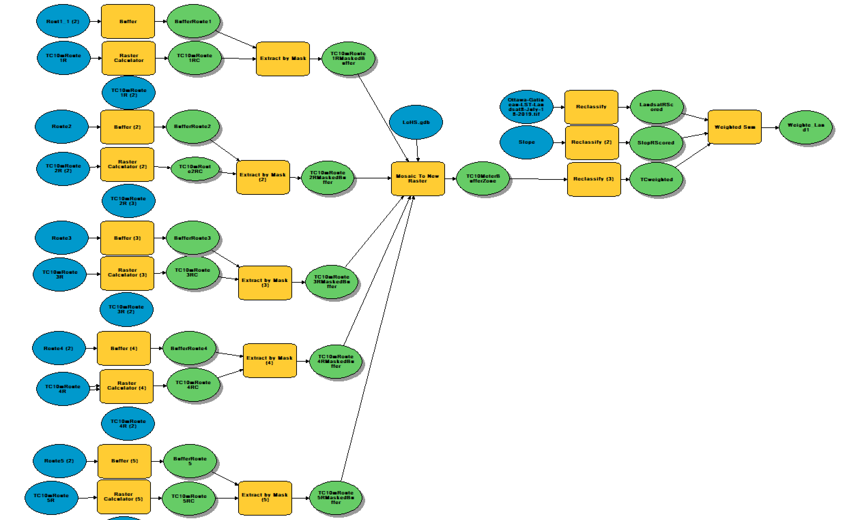
Step 2: (input data)

Slide 19
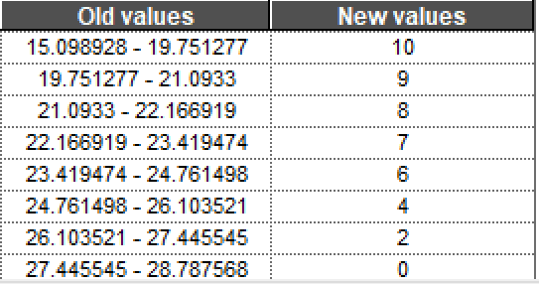
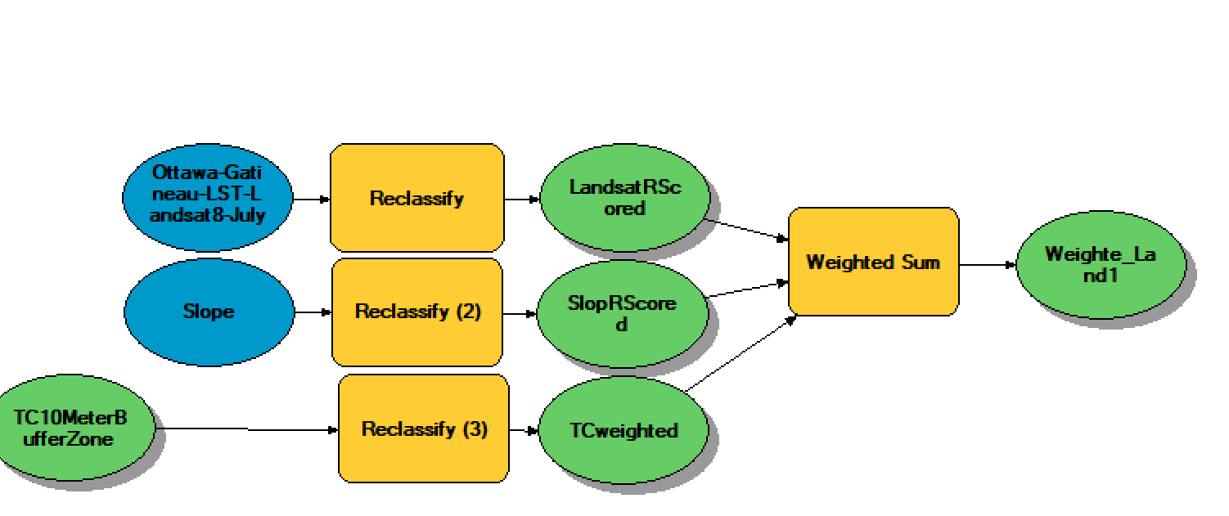
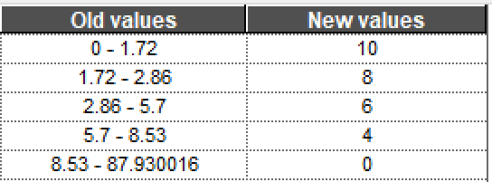
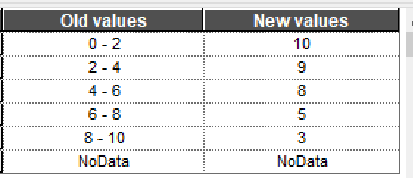
Step 3: (Process-Standardization)
The main process is the part that we do the index overlay method through “Weighted sum” tool. For this we need the standardize or data. Why ? Because the type of data are different. The slope is in degree, the Landsat values are in degree Celsius, and tree canopies are in meter. We have to score data to make them in one same measure to be comparable and become enable to weight them.
Because we are looking for suitability map of cycling in terms of heat stress level our scores will be defined based on this fact.
Don’t forget that the advantage of this classification is that it is very subjective. So, user can change this classification based on different purposes and different angle of view to the project.
The classification for Landsat image was done based on the natural breaks(Jenk) because natural breaks shows us the population of the values and it classifies the values based on the breaks that naturally exist in the data. This natural breaks shows the temperature classes with more meaningful visualization of map data and shows classes whose boundaries are set where there are relatively big differences in the data values.
The classification for slope was done manually with 5 classes. based on the literature review the break values for slope that cause rising human effort for cycling are 3% , 5% , 10%, 15% and more than 15%. Because our slope map was based on the degree we tried to identify those percentage in degree. So, our classes are 1.72, 2.86, 5.7 and 8.53
The classification for tree canopies was done manually based on previous studies that shows the far the trees the less shade they have on the routes.

Slide 20
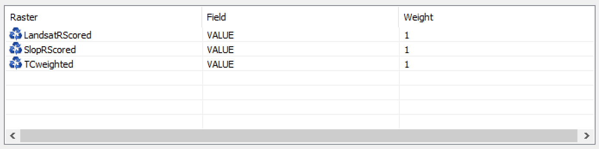
Step 3: (Process-Weighting)
Weighting means showing how much effect each type of data could have on the final result. This step is very subjective based on the purpose of the study. For example if the final results is going to be used for tree planting purpose we can weight the tree canopy effect more than others.
For this study I weight all data equally.

Slide 21
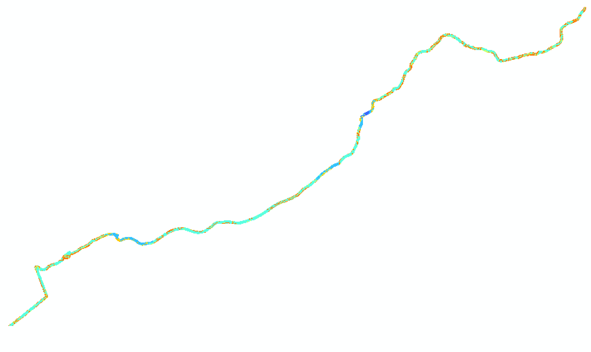
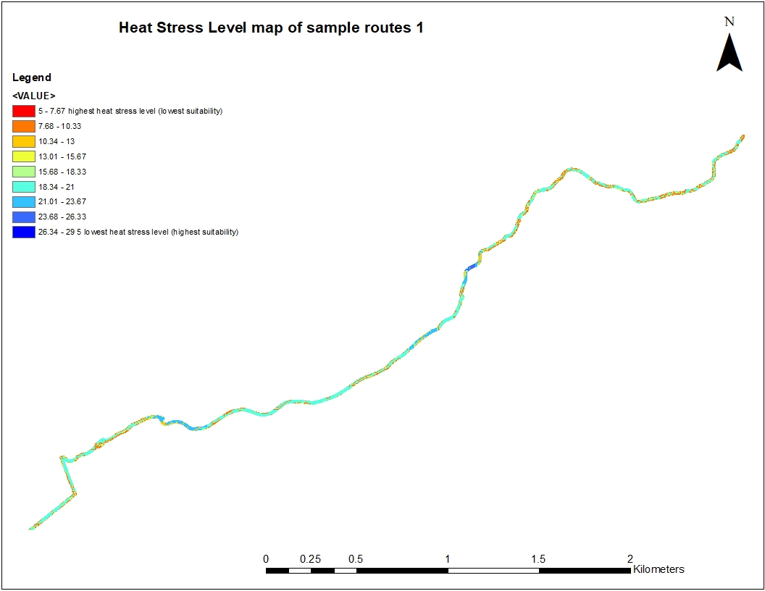
Step 4: Results (Route 1)

Slide 22
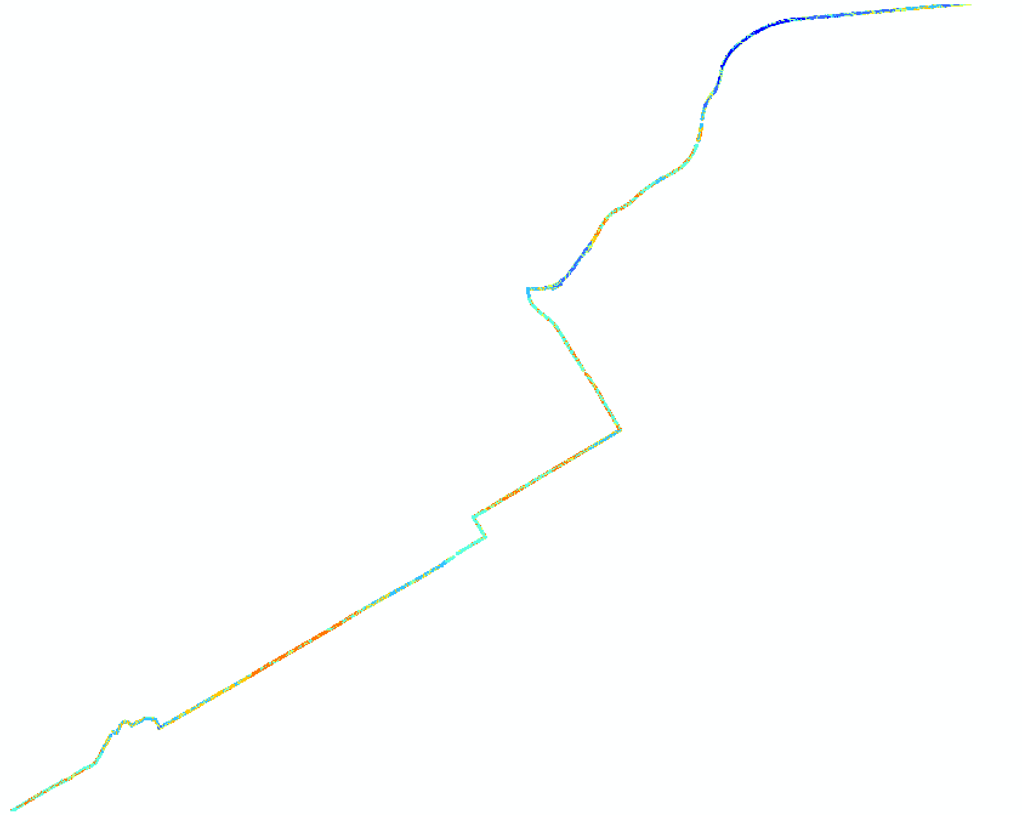
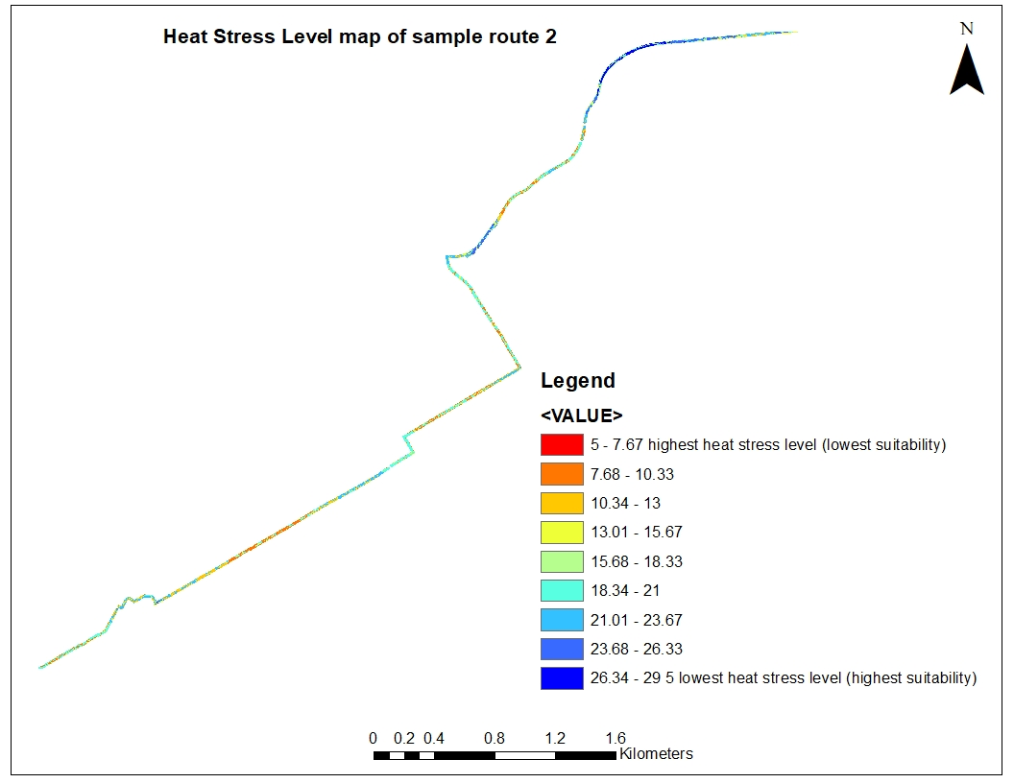
Step 4: Results (Route 2)

Slide 23
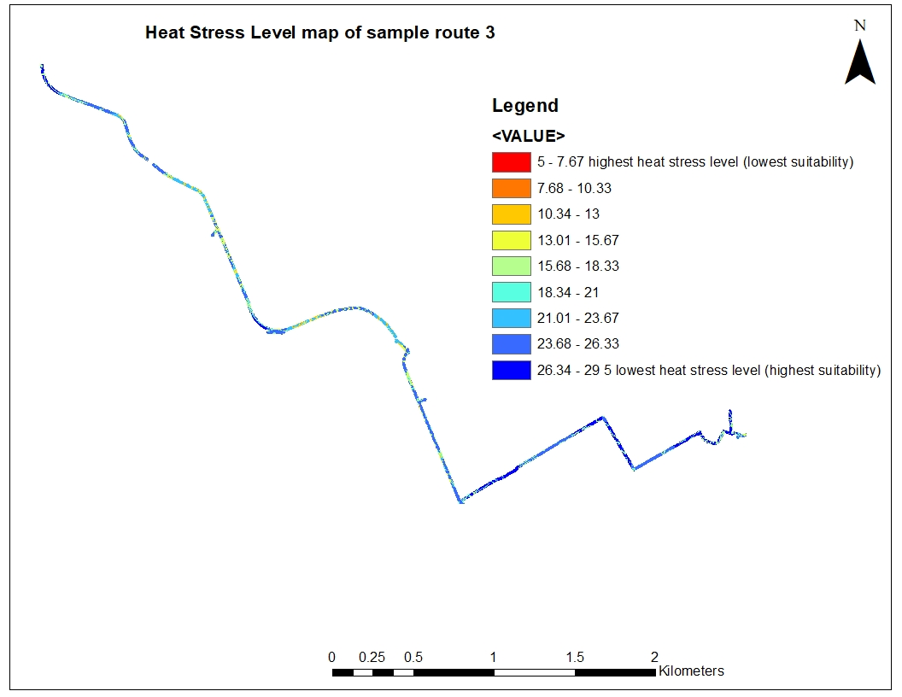
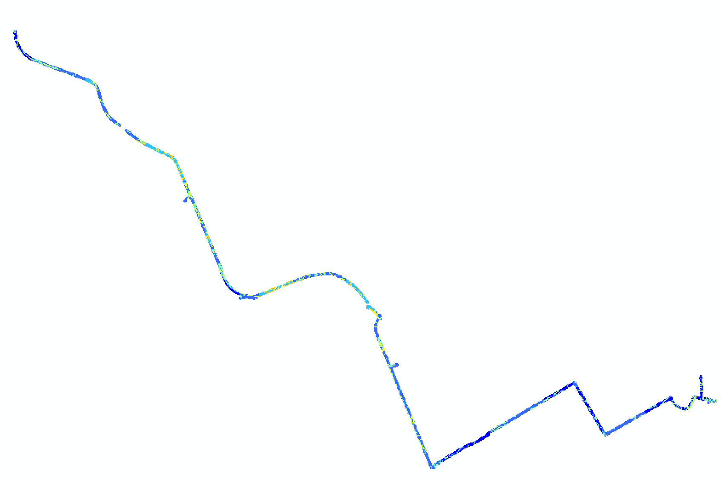
Step 4: Results (Route 3)

Slide 24
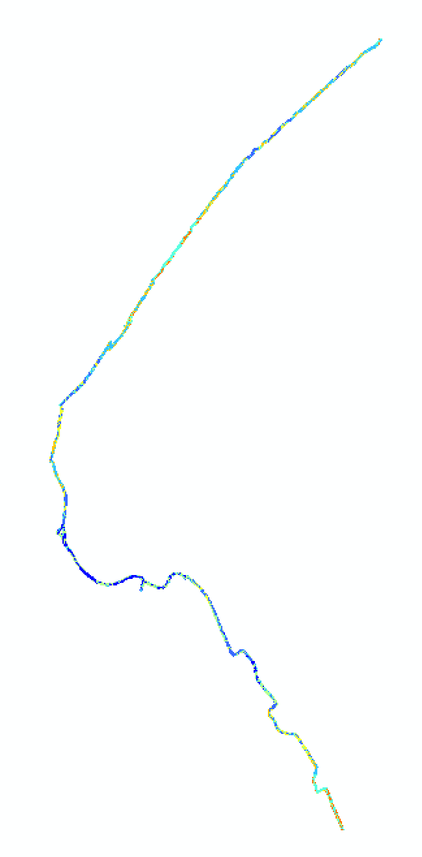
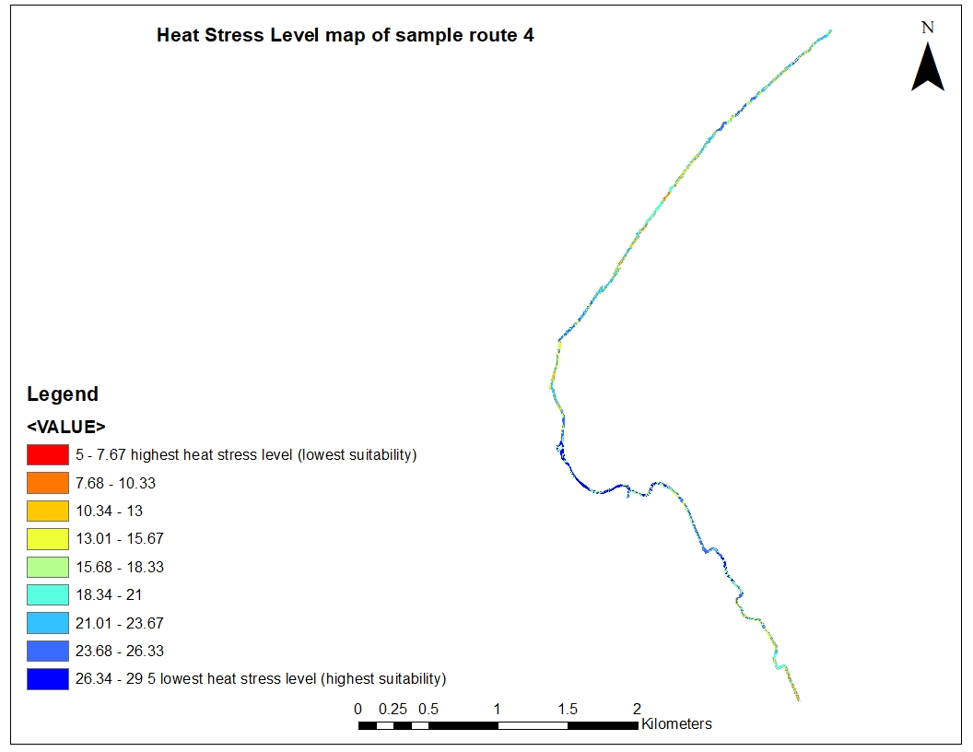
Step 4: Results (Route 4)

Slide 25
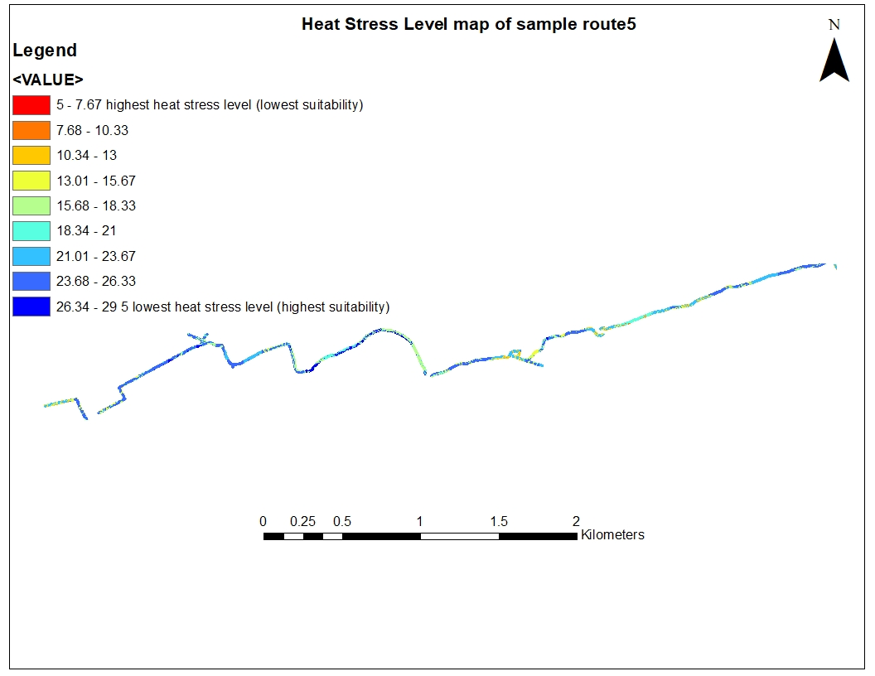
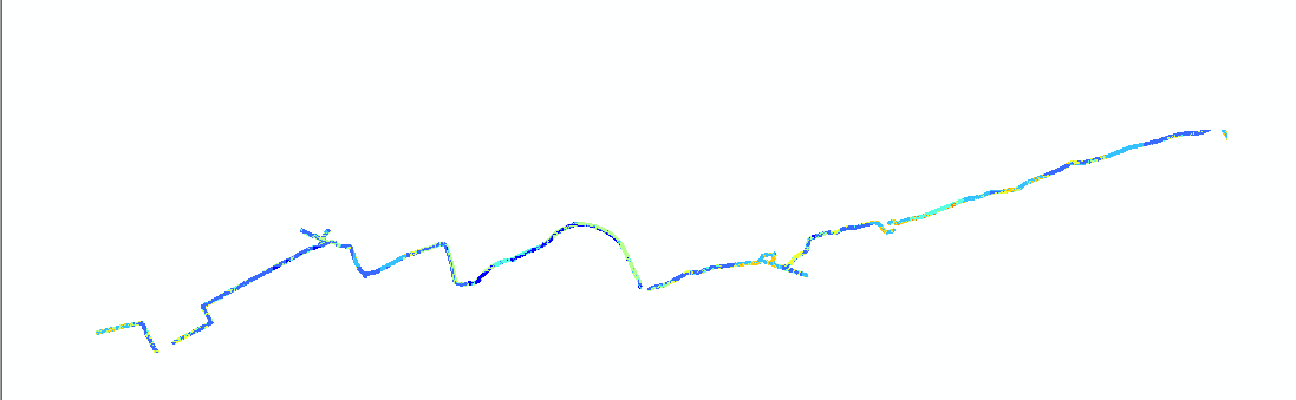
Step 4: Results (Route 5)

Slide 26
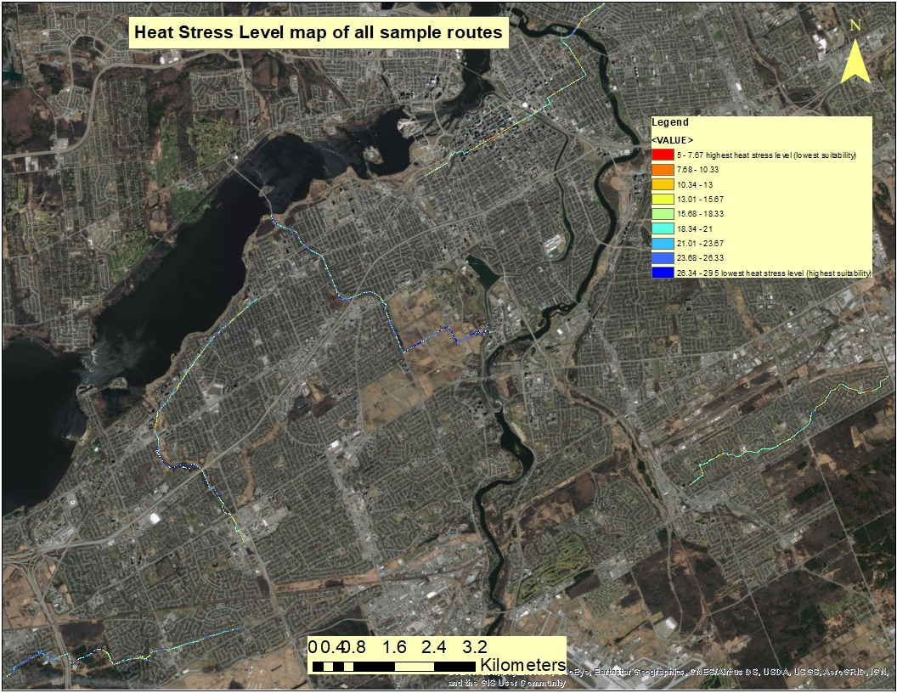
Step 4: Results
(All routes)

Slide 27
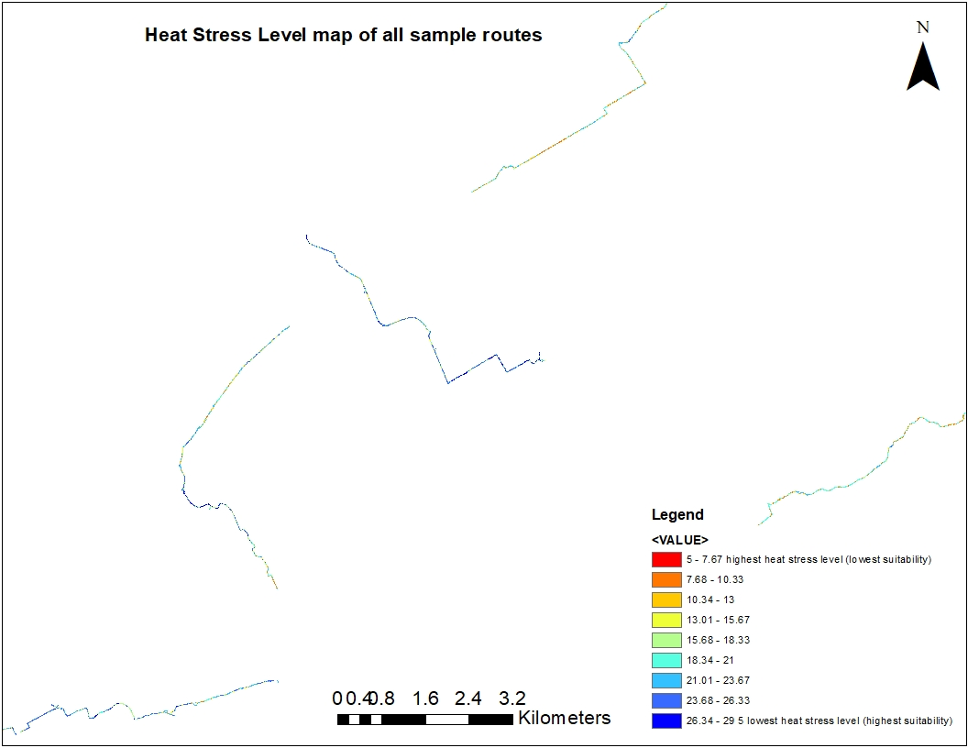
Step 4: Results
(All routes)
Route 2
Route 3
Route 4
Route 1
Route 5

Slide 28
Discussion
Comparing routes on the result maps, we can conclude that route 3,4 and 5 has the less heat stress level along the way. Then route 1 and then route 2 has less heat stress level.
The level of the heat is also shown along the way for each route through the maps. It shows which part of the route has more heat stress level.
These maps can be used for tree planting. The 1st , 2nd route may need more trees to be planted along the way.

Slide 29
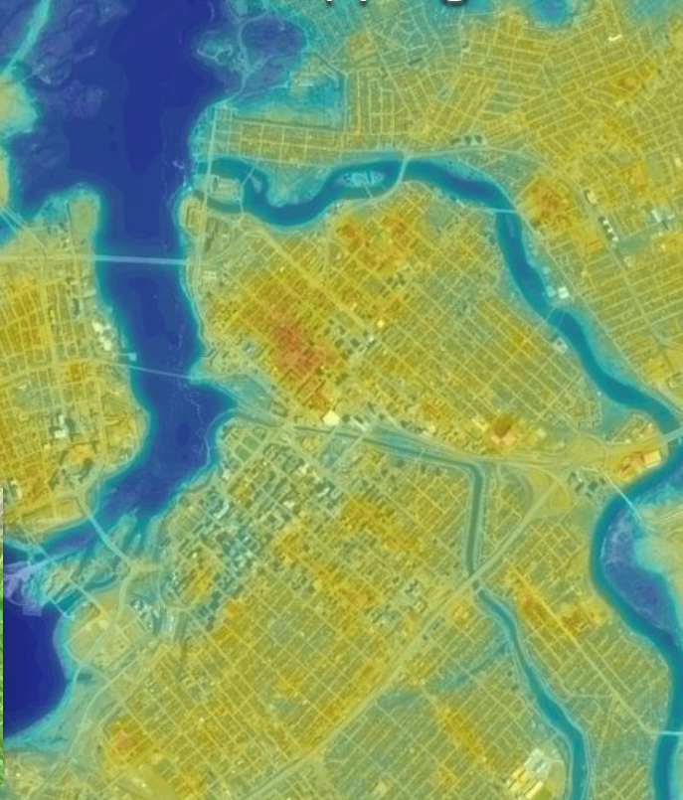
Thank You For Your Attention

